Slide 1
Intro to Dimensionality Reduction CSCI-347 Data Mining
Adiesha Liyana Ralalage

Slide 2
Goal
We'll explore the concept of high-dimensional space, also known as hyperspace.
This idea of high dimensionality might be unfamiliar to you.
Our goal is to become more comfortable with this concept and understand why high-dimensional space may be intuitive as low-dimensional space.

Slide 3
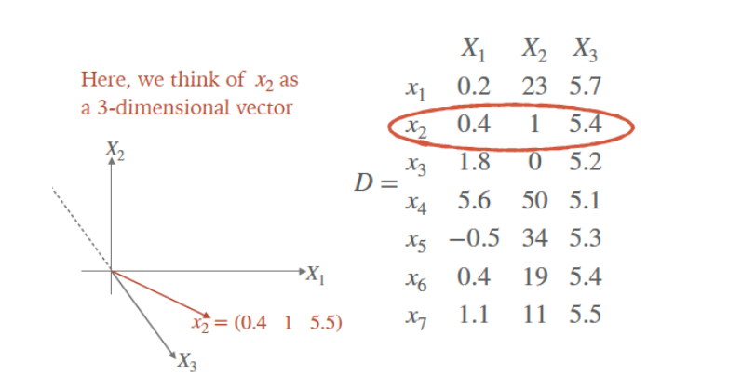
DATA REPRESENTATION IN N-DIMENSIONAL SPACE
Each instance/row/entity can be represented as a vector in m-dimensional space for m-dimensional data

Slide 4
Let’s think about problems of having high dimensional dataset
Intuitions from 2D and 3D space does not always work on high dimensional spaces.
Volume scales in non-intuitive ways.
Near and far becomes harder to differentiate.
Computing distances becomes more computationally expensive.
As result, algorithms on high-dimensional data becomes slower.

Slide 5
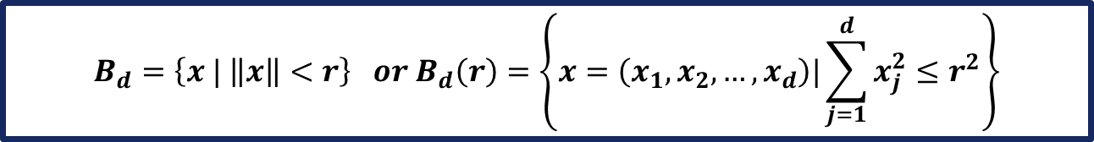
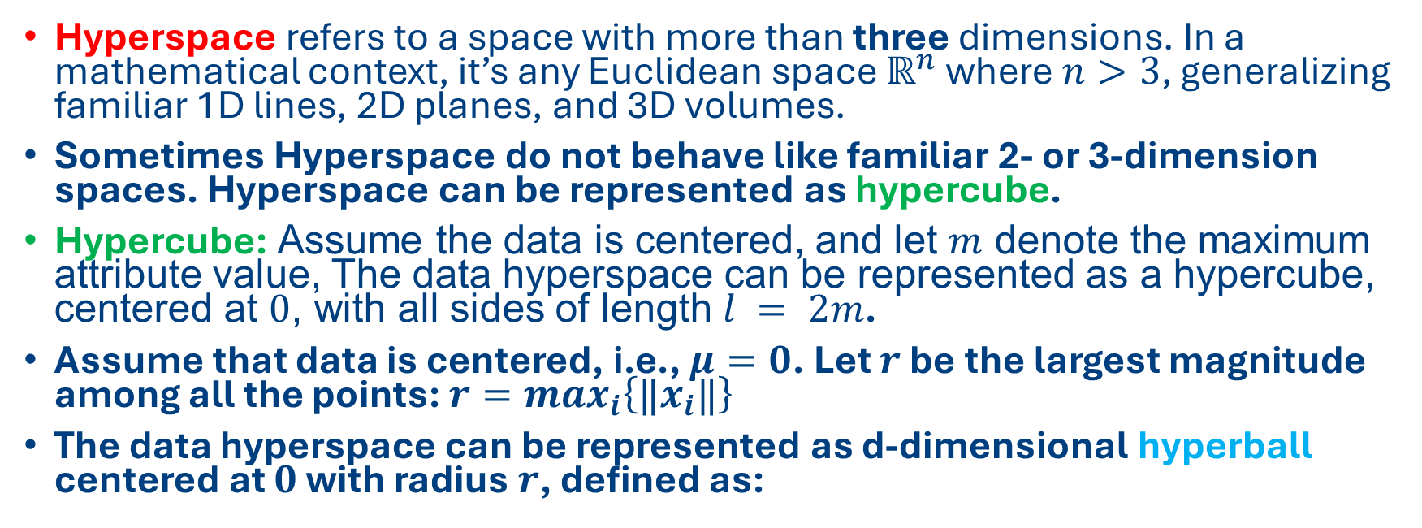
Hyperspace, Hypercube, Hyperball, Hypersphere
Hyperspace refers to a space with more than three dimensions. In a mathematical context, it’s any Euclidean space $ℝ^{n}$ where $n>3$, generalizing familiar 1D lines, 2D planes, and 3D volumes.
Sometimes Hyperspace do not behave like familiar 2- or 3-dimension spaces. Hyperspace can be represented as hypercube.
Hypercube: Assume the data is centered, and let $m$ denote the maximum attribute value, The data hyperspace can be represented as a hypercube, centered at $0$, with all sides of length $l = 2m$.
Assume that data is centered, i.e., $μ=0$. Let $r$ be the largest magnitude among all the points: $r=max_{i}\left\{‖x_{i}‖\right\}$
The data hyperspace can be represented as d-dimensional hyperball centered at $0$ with radius $r$, defined as:
$$B_{d}=\left\{x | \left\|x\right\|<r\right\} or B_{d}\left(r\right)=\left\{x=\left(x_{1}, x_{2}, …, x_{d}\right)|\sum_{j=1}^{d}{x_{j}^{2}≤r^{2}}\right\}$$

Slide 6

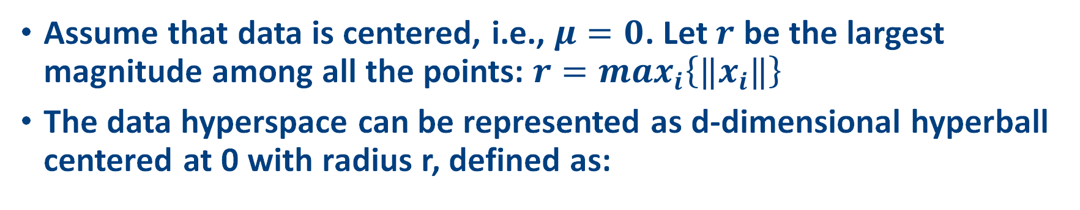

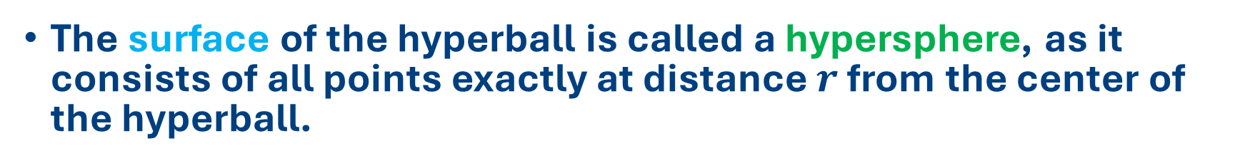
Hyperspace, Hypercube, Hyperball, Hypersphere
Assume that data is centered, i.e., $μ=0$. Let $r$ be the largest magnitude among all the points: $r=max_{i}\left\{‖x_{i}‖\right\}$
The data hyperspace can be represented as d-dimensional hyperball centered at 0 with radius r, defined as:
$$B_{d}=\left\{x | \left\|x\right\|<r\right\} or B_{d}\left(r\right)=\left\{x=\left(x_{1}, x_{2}, …, x_{d}\right)|\sum_{j=1}^{d}{x_{j}^{2}≤r^{2}}\right\}$$
The surface of the hyperball is called a hypersphere, as it consists of all points exactly at distance $r$ from the center of the hyperball.
$$S_{d}\left(r\right)=\left\{x : \left\|x\right\|=r\right\}$$
$$or$$
$$S_{d}\left(r\right)=\left\{x=\left(x_{1}, x_{2}, …, x_{d}\right) |\sum_{j=1}^{d}{x_{j}^{2}=r^{2}}\right\}$$

Slide 7
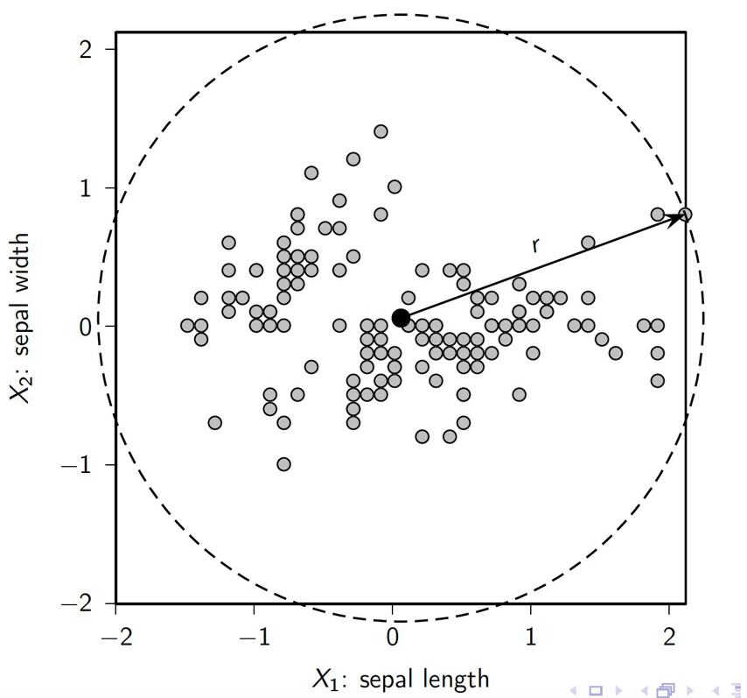
IRIS DATA HYPERSPACE: HYPERCUBE AND HYPERSPHERE

Slide 8
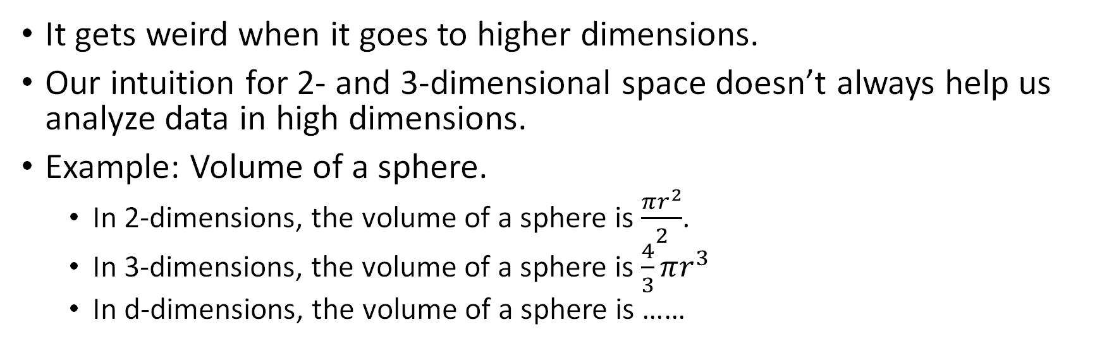
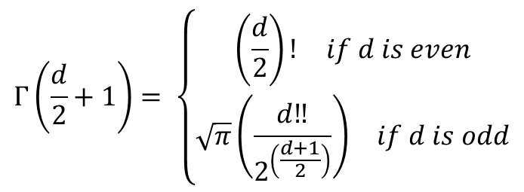
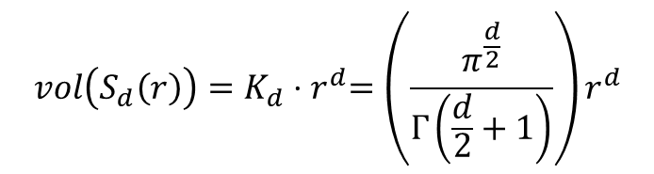
What happens in high dimensions?
It gets weird when it goes to higher dimensions.
Our intuition for 2- and 3-dimensional space doesn’t always help us analyze data in high dimensions.
Example: Volume of a sphere.
In 2-dimensions, the volume of a sphere is $\frac{πr^{2}}{2}$.
In 3-dimensions, the volume of a sphere is $\frac{4}{3}πr^{3}$
In d-dimensions, the volume of a sphere is ……
$$vol\left(S_{d}\left(r\right)\right)=K_{d}{⋅r}^{d}=\left(\frac{π^{\frac{d}{2}}}{Γ\left(\frac{d}{2}+1\right)}\right)r^{d}$$
$$Γ\left(\frac{d}{2}+1\right)= \left\{\begin{aligned}\begin{matrix}\left(\frac{d}{2}\right)! & if d is even\end{matrix} \\ \begin{matrix}\sqrt{π}\left(\frac{d‼}{2^{\left(\frac{d+1}{2}\right)}}\right) & if d is odd\end{matrix}\end{aligned}\right.$$
Euler’s gamma function
Notes:
skips every other number

Slide 9

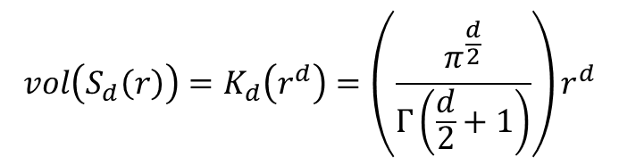
What happens in high dimensions?
Let’s do a in-class activity: Compute the volume of a sphere with radius 1 in 4 dimensions and 12 dimensions.
$$Γ\left(\frac{d}{2}+1\right)= \left\{\begin{aligned}\begin{matrix}\left(\frac{d}{2}\right)! & if d is even\end{matrix} \\ \begin{matrix}\sqrt{π}\left(\frac{d!}{2^{\left(\frac{d+1}{2}\right)}}\right) & if d is odd\end{matrix}\end{aligned}\right.$$
$$vol\left(S_{d}\left(r\right)\right)=K_{d}\left(r^{d}\right)=\left(\frac{π^{\frac{d}{2}}}{Γ\left(\frac{d}{2}+1\right)}\right)r^{d}$$

Slide 10
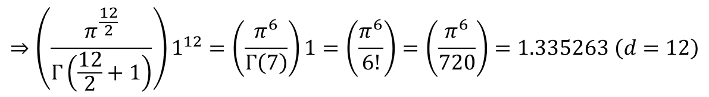
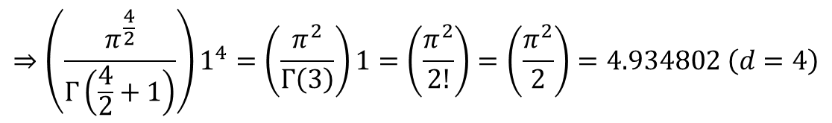
What happens in high dimensions?
Let’s do a in-class activity: Compute the volume of a sphere with radius 1 in 4 dimensions and 12 dimensions.
$$Γ\left(\frac{d}{2}+1\right)= \left\{\begin{aligned}\begin{matrix}\left(\frac{d}{2}\right)! & if d is even\end{matrix} \\ \begin{matrix}\sqrt{π}\left(\frac{d!}{2^{\left(\frac{d+1}{2}\right)}}\right) & if d is odd\end{matrix}\end{aligned}\right.$$
$$vol\left(S_{d}\left(r\right)\right)=K_{d}\left(r^{d}\right)=\left(\frac{π^{\frac{d}{2}}}{Γ\left(\frac{d}{2}+1\right)}\right)r^{d}$$
$$⇒\left(\frac{π^{\frac{4}{2}}}{Γ\left(\frac{4}{2}+1\right)}\right)1^{4}=\left(\frac{π^{2}}{Γ\left(3\right)}\right)1=\left(\frac{π^{2}}{2!}\right)=\left(\frac{π^{2}}{2}\right)=4.934802 \left(d=4\right)$$
$$⇒\left(\frac{π^{\frac{12}{2}}}{Γ\left(\frac{12}{2}+1\right)}\right)1^{12}=\left(\frac{π^{6}}{Γ\left(7\right)}\right)1=\left(\frac{π^{6}}{6!}\right)=\left(\frac{π^{6}}{720}\right)=1.335263 \left(d=12\right)$$

Slide 11
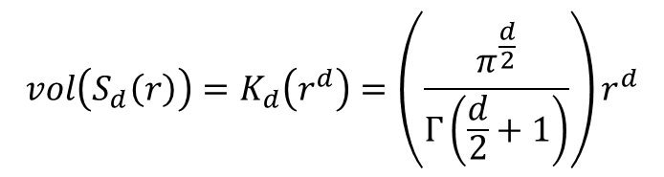

What happens in high dimensions?
It gets weird when it goes to higher dimensions.
Our intuition for 2- and 3-dimensional space doesn’t always help us analyze data in high dimensions.
Example: Volume of a sphere.
In 2-dimensions, the volume of a sphere is $\frac{πr^{2}}{2}$.
In 3-dimensions, the volume of a sphere is $\frac{4}{3}πr^{3}$
In d-dimensions, the volume of a sphere is ……
$$vol\left(S_{d}\left(r\right)\right)=K_{d}\left(r^{d}\right)=\left(\frac{π^{\frac{d}{2}}}{Γ\left(\frac{d}{2}+1\right)}\right)r^{d}$$
$$Γ\left(\frac{d}{2}+1\right)= \left\{\begin{aligned}\begin{matrix}\left(\frac{d}{2}\right)! & if d is even\end{matrix} \\ \begin{matrix}\sqrt{π}\left(\frac{d‼}{2^{\left(\frac{d+1}{2}\right)}}\right) & if d is odd\end{matrix}\end{aligned}\right.$$
As dimensionality increases, the volume increases up to a point then decreases again.
Let’s look at an experiment.

Slide 12
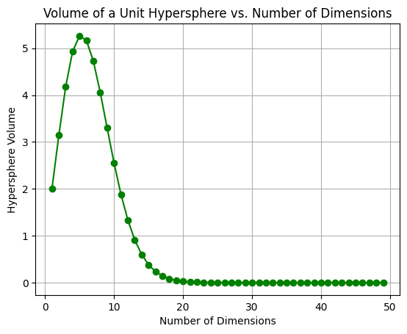
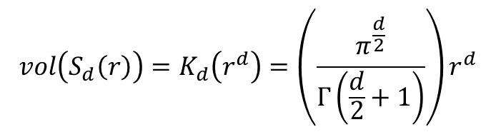
What happens in high dimensions?
In d-dimensions, the volume of a sphere increases up to a point, then decreases.
$$vol\left(S_{d}\left(r\right)\right)=K_{d}\left(r^{d}\right)=\left(\frac{π^{\frac{d}{2}}}{Γ\left(\frac{d}{2}+1\right)}\right)r^{d}$$

Slide 13
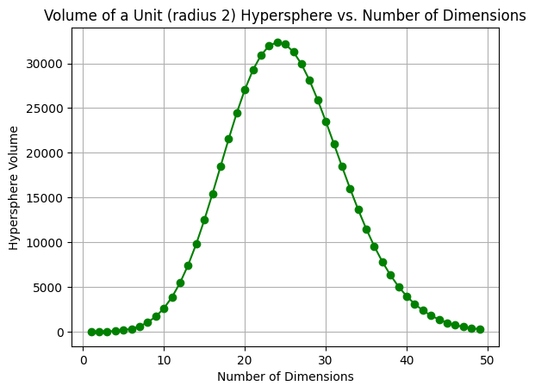
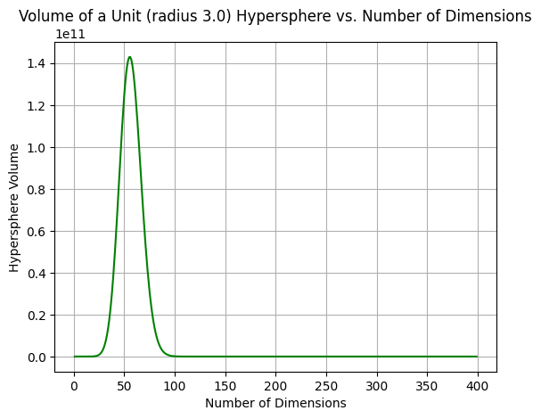
What happens in high dimensions?
In d-dimensions, the volume of a sphere increases up to a point, then decreases.

Slide 14
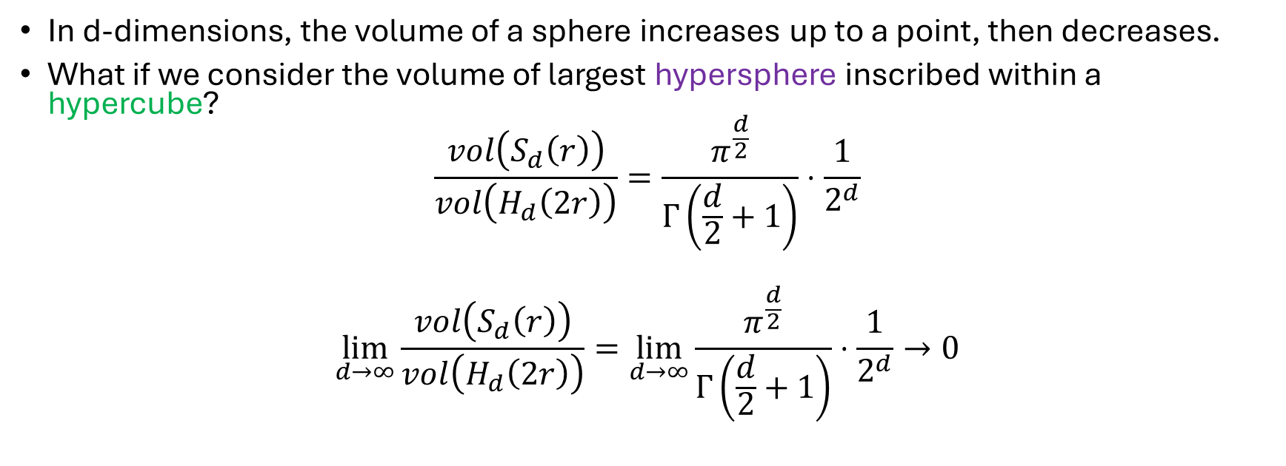
What happens in high dimensions?
In d-dimensions, the volume of a sphere increases up to a point, then decreases.
What if we consider the volume of largest hypersphere inscribed within a hypercube?
$$\frac{vol\left(S_{d}\left(r\right)\right)}{vol\left(H_{d}\left(2r\right)\right)}=\frac{π^{\frac{d}{2}}}{Γ\left(\frac{d}{2}+1\right)}⋅\frac{1}{2^{d}}$$
$$\lim_{d→∞}{\frac{vol\left(S_{d}\left(r\right)\right)}{vol\left(H_{d}\left(2r\right)\right)}}=\lim_{d→∞}\frac{π^{\frac{d}{2}}}{Γ\left(\frac{d}{2}+1\right)}⋅\frac{1}{2^{d}}→0$$

Slide 15
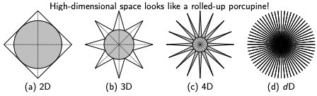
What happens in high dimensions?
In d-dimensions, the volume of a sphere increases up to a point, then decreases.
What if we consider the volume of largest hypersphere inscribed within a hypercube?
As the dimensionality increases, most of the volume of the hypercube is in the “corners,” whereas the center is essentially empty.

Slide 16
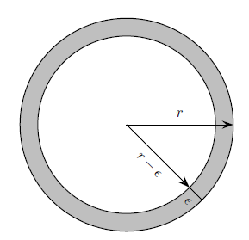
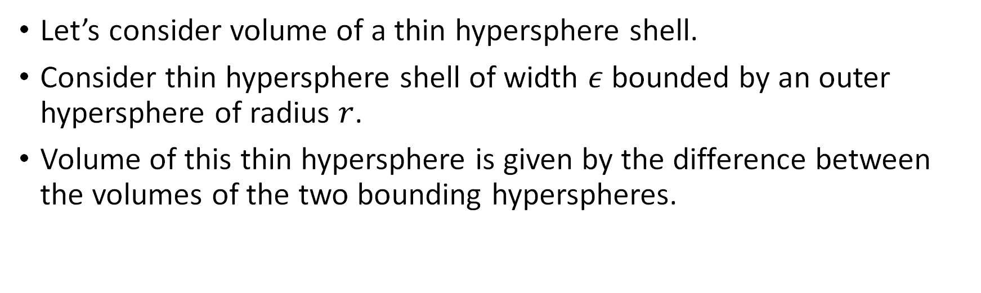
What happens in high dimensions?
Let’s consider volume of a thin hypersphere shell.
Consider thin hypersphere shell of width $ε$bounded by an outer hypersphere of radius $r$.
Volume of this thin hypersphere is given by the difference between the volumes of the two bounding hyperspheres.

Slide 17
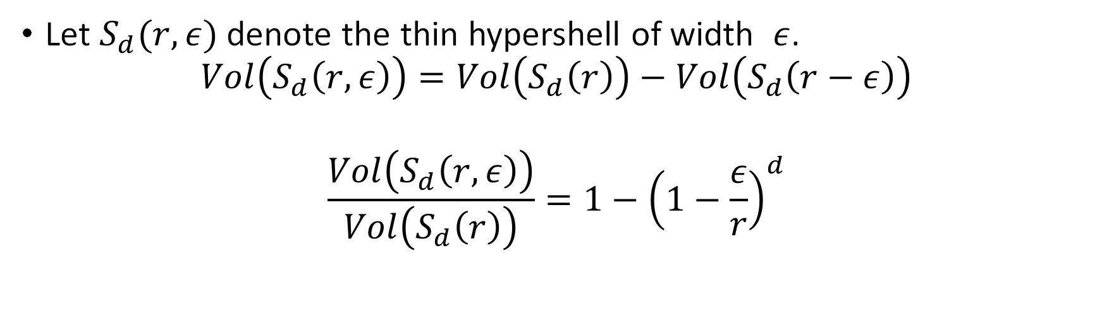
What happens in high dimensions?
Let $S_{d}(r, ε)$ denote the thin hypershell of width $ε$.
$$Vol\left(S_{d}\left(r, ε\right)\right)=Vol\left(S_{d}\left(r\right)\right)−Vol\left(S_{d}\left(r−ε\right)\right)$$
$$\frac{Vol\left(S_{d}\left(r, ε\right)\right)}{Vol\left(S_{d}\left(r\right)\right)}=1−{\left(1−\frac{ε}{r}\right)}^{d}$$

Slide 18
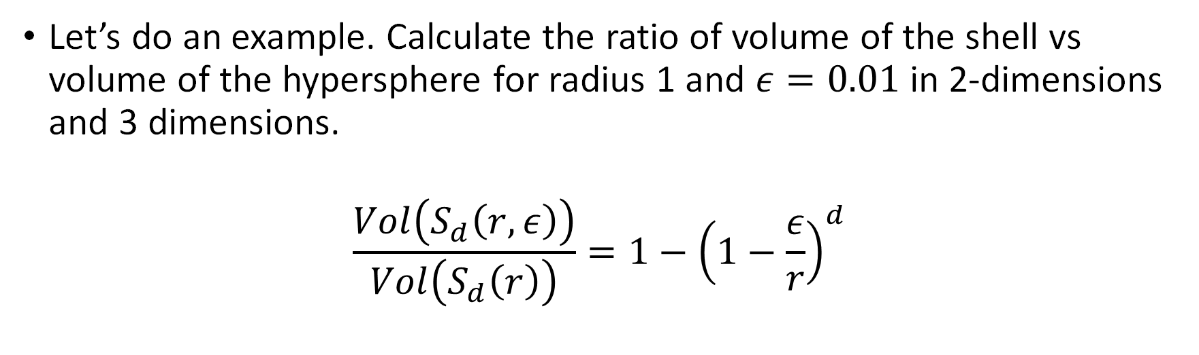
What happens in high dimensions?
Let’s do an example. Calculate the ratio of volume of the shell vs volume of the hypersphere for radius 1 and $ε=0.01$ in 2-dimensions and 3 dimensions.
$$\frac{Vol\left(S_{d}\left(r, ε\right)\right)}{Vol\left(S_{d}\left(r\right)\right)}=1−{\left(1−\frac{ε}{r}\right)}^{d}$$

Slide 19
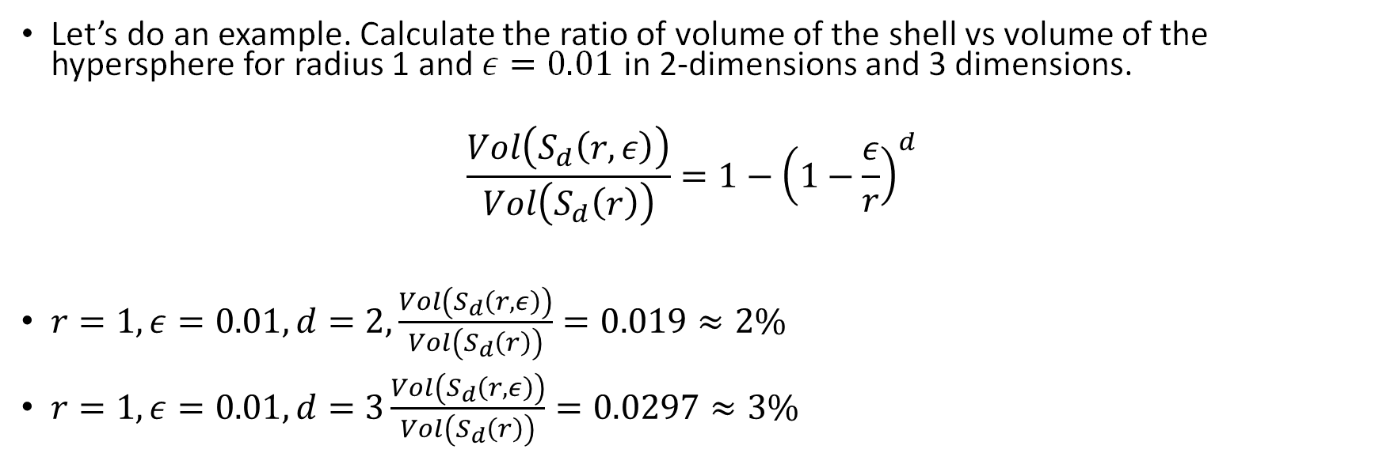
What happens in high dimensions?
Let’s do an example. Calculate the ratio of volume of the shell vs volume of the hypersphere for radius 1 and $ε=0.01$ in 2-dimensions and 3 dimensions.
$$\frac{Vol\left(S_{d}\left(r, ε\right)\right)}{Vol\left(S_{d}\left(r\right)\right)}=1−{\left(1−\frac{ε}{r}\right)}^{d}$$
$r=1, ε=0.01,d=2, \frac{Vol\left(S_{d}\left(r, ε\right)\right)}{Vol\left(S_{d}\left(r\right)\right)}=0.019≈2\%$
$r=1, ε=0.01,d=3\frac{Vol\left(S_{d}\left(r, ε\right)\right)}{Vol\left(S_{d}\left(r\right)\right)}=0.0297≈3\%$

Slide 20
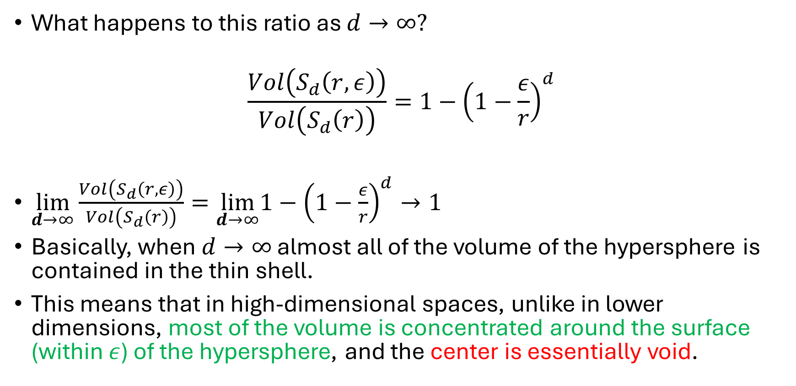
What happens in high dimensions?
What happens to this ratio as $d→∞?$
$$\frac{Vol\left(S_{d}\left(r, ε\right)\right)}{Vol\left(S_{d}\left(r\right)\right)}=1−{\left(1−\frac{ε}{r}\right)}^{d}$$
$\lim_{d→∞}{\frac{Vol\left(S_{d}\left(r, ε\right)\right)}{Vol\left(S_{d}\left(r\right)\right)}}=\lim_{d→∞}1−{\left(1−\frac{ε}{r}\right)}^{d}→1$
Basically, when $d→∞$ almost all of the volume of the hypersphere is contained in the thin shell.
This means that in high-dimensional spaces, unlike in lower dimensions, most of the volume is concentrated around the surface (within $ε$) of the hypersphere, and the center is essentially void.

Slide 21
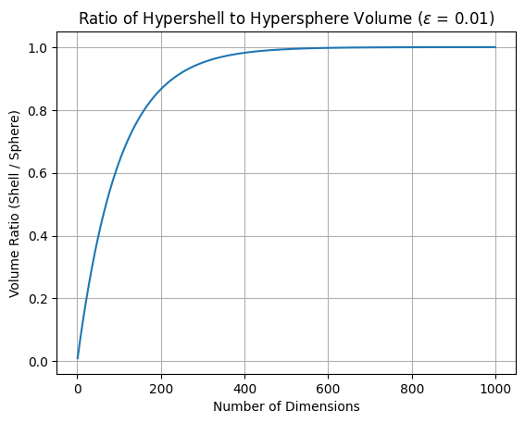


What happens in high dimensions?
What happens to this ratio as $d→∞?$
$$\frac{Vol\left(S_{d}\left(r, ε\right)\right)}{Vol\left(S_{d}\left(r\right)\right)}=1−{\left(1−\frac{ε}{r}\right)}^{d}$$
$\lim_{d→∞}{\frac{Vol\left(S_{d}\left(r, ε\right)\right)}{Vol\left(S_{d}\left(r\right)\right)}}=1−{\left(1−\frac{ε}{r}\right)}^{d}→1$
Basically, when $d→∞$ almost all of the volume of the hypersphere is contained in the thin shell.
This means that in high-dimensional spaces, unlike in lower dimensions, most of the volume is concentrated around the surface (within $ε$) of the hypersphere, and the center is essentially void.
What happens to this ratio as $d→∞?$
$$\frac{Vol\left(S_{d}\left(r, ε\right)\right)}{Vol\left(S_{d}\left(r\right)\right)}=1−{\left(1−\frac{ε}{r}\right)}^{d}$$

Slide 22
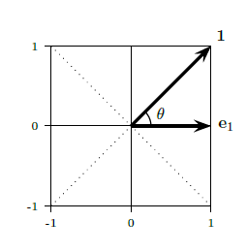
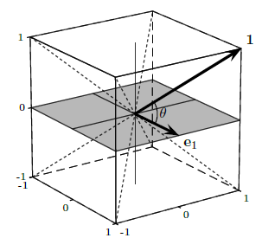
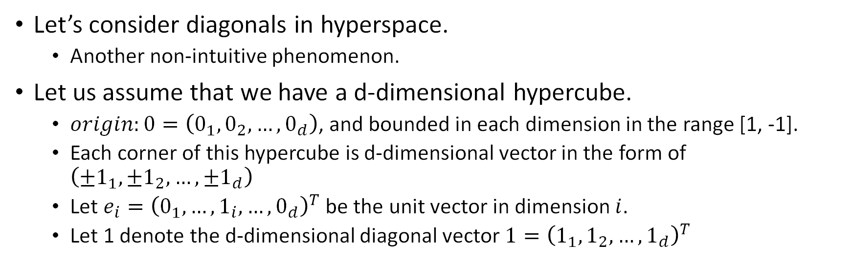
What happens in high dimensions?
Let’s consider diagonals in hyperspace.
Another non-intuitive phenomenon.
Let us assume that we have a d-dimensional hypercube.
$origin:0=\left(0_{1},0_{2},…, 0_{d}\right)$, and bounded in each dimension in the range [1, -1].
Each corner of this hypercube is d-dimensional vector in the form of $\left(±1_{1},±1_{2},…,±1_{d}\right)$
Let $e_{i}={\left(0_{1},…, 1_{i}, …, 0_{d}\right)}^{T}$ be the unit vector in dimension $i$.
Let 1 denote the d-dimensional diagonal vector $1={\left(1_{1},1_{2},…, 1_{d}\right)}^{T}$

Slide 23
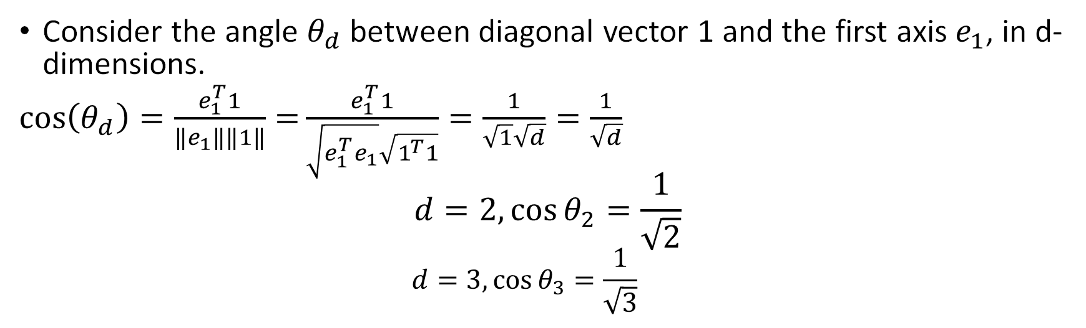
What happens in high dimensions?
Consider the angle $θ_{d}$ between diagonal vector 1 and the first axis $e_{1}$, in d-dimensions.
$\cos\left(θ_{d}\right)=\frac{e_{1}^{T}1}{‖e_{1}‖‖1‖}=\frac{e_{1}^{T}1}{\sqrt{e_{1}^{T}e_{1}}\sqrt{1^{T}1}}=\frac{1}{\sqrt{1}\sqrt{d}}=\frac{1}{\sqrt{d}}$
$$d=2, {\cos{θ}}_{2}=\frac{1}{\sqrt{2}}$$
$$d=3,\cos{θ_{3}}=\frac{1}{\sqrt{3}}$$

Slide 24
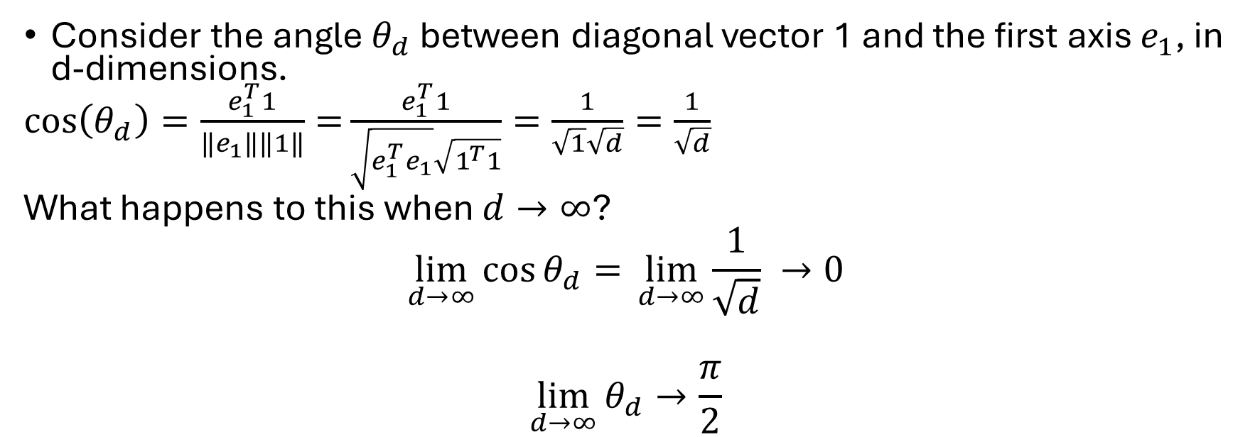
What happens in high dimensions?
Consider the angle $θ_{d}$ between diagonal vector 1 and the first axis $e_{1}$, in d-dimensions.
$\cos\left(θ_{d}\right)=\frac{e_{1}^{T}1}{‖e_{1}‖‖1‖}=\frac{e_{1}^{T}1}{\sqrt{e_{1}^{T}e_{1}}\sqrt{1^{T}1}}=\frac{1}{\sqrt{1}\sqrt{d}}=\frac{1}{\sqrt{d}}$
What happens to this when $d→∞$?
$$\lim_{d→∞}{\cos{θ_{d}}=} \lim_{d→∞}\frac{1}{\sqrt{d}} →0$$
$$\lim_{d→∞}{θ_{d}}→\frac{π}{2}$$

Slide 25
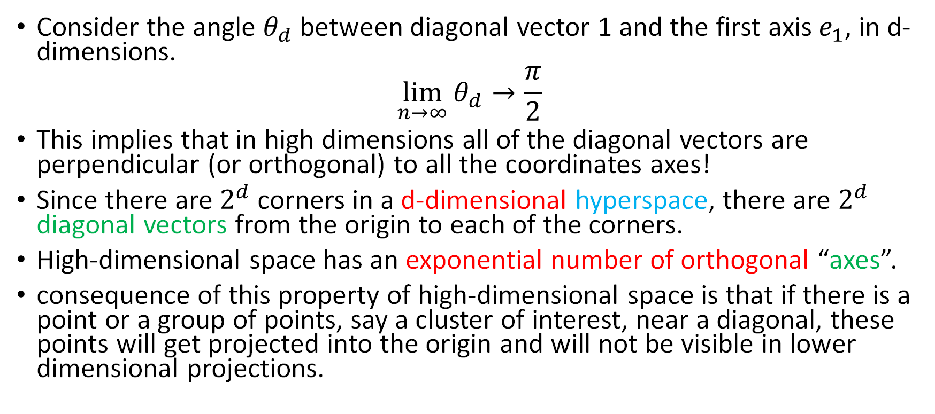
What happens in high dimensions?
Consider the angle $θ_{d}$ between diagonal vector 1 and the first axis $e_{1}$, in d-dimensions.
$$\lim_{n→∞}{θ_{d}}→\frac{π}{2}$$
This implies that in high dimensions all of the diagonal vectors are perpendicular (or orthogonal) to all the coordinates axes!
Since there are $2^{d}$ corners in a d-dimensional hyperspace, there are $2^{d}$ diagonal vectors from the origin to each of the corners.
High-dimensional space has an exponential number of orthogonal “axes”.
consequence of this property of high-dimensional space is that if there is a point or a group of points, say a cluster of interest, near a diagonal, these points will get projected into the origin and will not be visible in lower dimensional projections.

Slide 26
What happens in high dimensions?
As dimensionality increases, the volume of a sphere with radius 1 increases up to a point and vanishes as
As the dimensionality increases, most of the volume of the hypercube is in the “corners,” whereas the center is essentially empty.
Consider a hypersphere inscribed inside a hypercube. As dimensionality increases, all the volume of the hyperspace is in the corners of the cube!
The distance between the nearest neighbor of a point and the farthest neighbor of a point get closer together as dimensionality increases, making it difficult to find true “nearest neighbors”

Slide 27
What happens in high dimensions?
As dimensionality increases, the volume of a sphere with radius 1 increases up to a point and vanishes as the dimensionality increases, most of the volume of the hypercube is in the “corners,” whereas the center is essentially empty. (Sparsity)
In high dimensions all the diagonal vectors are perpendicular (or orthogonal) to all the coordinates axes! (Geometric Intuition Breakdown)
The distance between the nearest neighbor of a point and the farthest neighbor of a point get closer together as dimensionality increases, making it difficult to find true “nearest neighbors” (Distance Concentration)
This is called Curse of dimensionality

Slide 28
How can we find the best low-dimensional representation of the data?
How can we reduce the dimensionality without losing information?

Slide 29
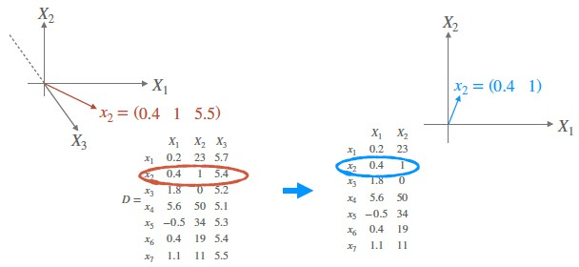
How can we find the best low-dimensional representation of the data?
Dimensionality reduction can be accomplished by:
Selecting a subset of attributes of the dataset.
What are the possible advantages and disadvantages?

Slide 30
Ideas to reduce dimensionality
Selecting a subset of attributes of the dataset
Advantages
Reduced Complexity
Improved Model Performance
Enhanced Data Visualization
Reduced Storage Requirements
Increased Interpretability
Disadvantages
Potential Loss of Information
Removing features can lead to the loss of valuable information, which may negatively impact model performance.
It is crucial to carefully select features to minimize information loss.
Risk of Bias
If the feature selection process is biased, it can lead to a model that is not representative of the underlying data.

Slide 31
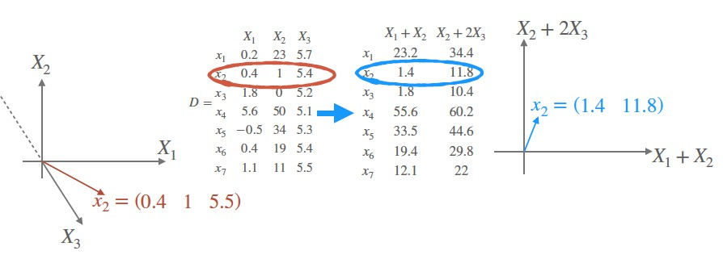
How can we find the best low-dimensional representation of the data?
Dimensionality reduction can be accomplished by:
Selecting a subset of attributes of the dataset.
What are the possible advantages and disadvantages?
Using all the attributes to create new attributes that can represent the data

Slide 32
Ideas to reduce dimensionality
Using all the attributes to create new attributes that can represent the data
Advantages
Capturing Complex Relationships
May reveal hidden relationships
Increased Model Accuracy
Domain Knowledge Integration
Disadvantages
Increased Complexity
Increased Computational Cost

